Slide 1
Modern Theming
In Angular and Material

Slide 2
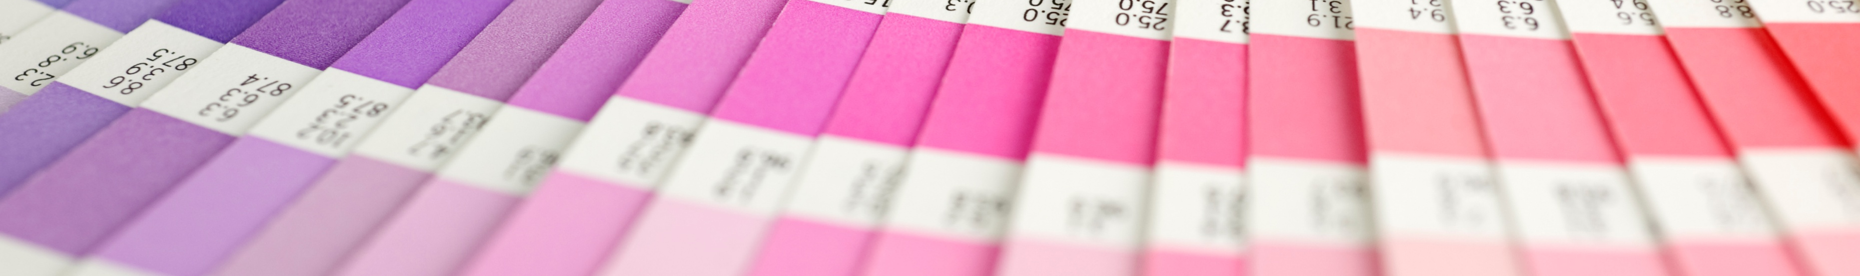




Kobi Hari
Freelancer
Developer, Instructor and Consultant
Angular, Async development, .NET core
My email: hari@applicolors.com
Courses on Udemy: https://www.udemy.com/user/kobi-hari/
My Angular Channel: https://www.youtube.com/@kobihari

Slide 3

GitHub Repository
https://github.com/kobi-hari-courses/2506-angularTlv-meetup

Slide 4

This lecture is about
not
AI
Angular Material
Angular… actually

Slide 5
This lecture is about
yes
Demo app with chat bots
AI
Angular Material
The new approach of to theming
V20 of
Angular… actually

Slide 6

“Angular Material” is known for
Problematic code
Hard to customize
Breaks every few versions
But why?

Slide 7
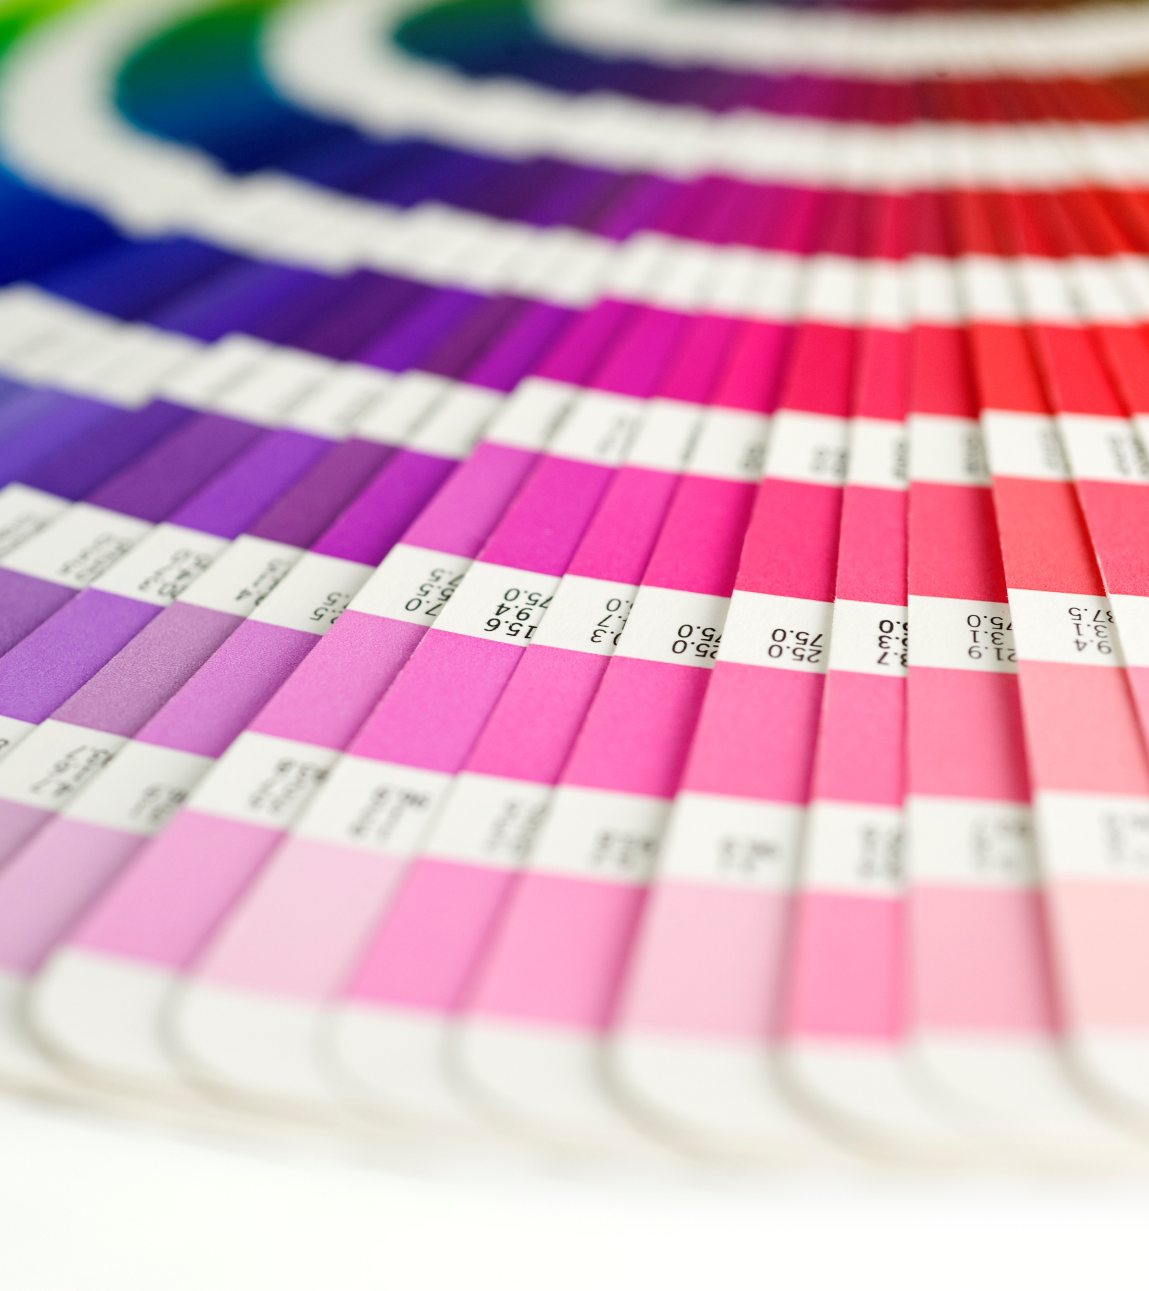
Theming
Consistent Graphical Concept
Reuse colors, fonts, icons

Slide 8
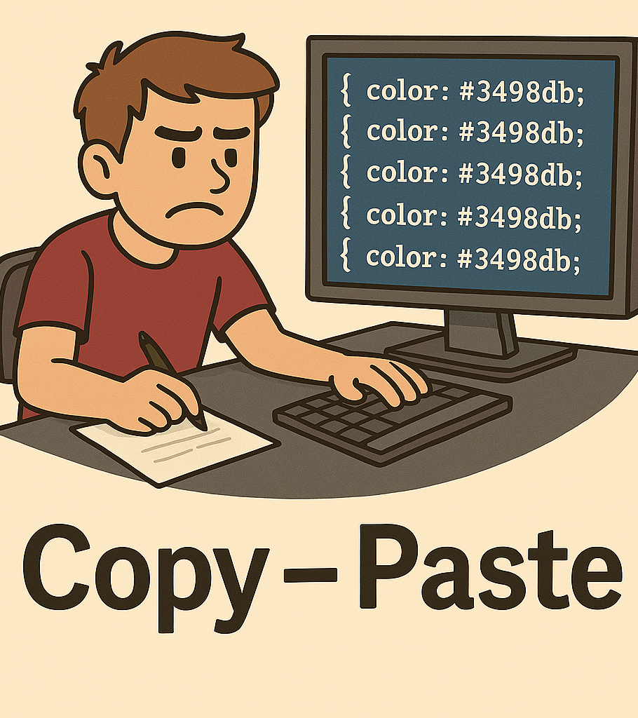
CSS Challenges
No “variables”
No “constants”
No “functions”
* at least not in 2015

Slide 9

Sass to the rescue?
It has Variables, Constants, Functions
But… It’s only in Compile time
It generates the same “bad” CSS
This Photo by Unknown Author is licensed under CC BY-SA

Slide 10
styles.scss
@use '@angular/material’ as mat;
@include mat.core();
$my-primary: mat.define-palette(mat.$indigo-palette);
$my-accent: mat.define-palette(mat.$pink-palette);
$my-warn: mat.define-palette(mat.$red-palette);
$my-theme: mat.define-light-theme((
color: (
primary: $my-primary,
accent: $my-accent,
warn: $my-warn,
),
typography: mat.define-typography-config(),
density: 0,
));
@include mat.all-component-themes($my-theme);

Slide 11
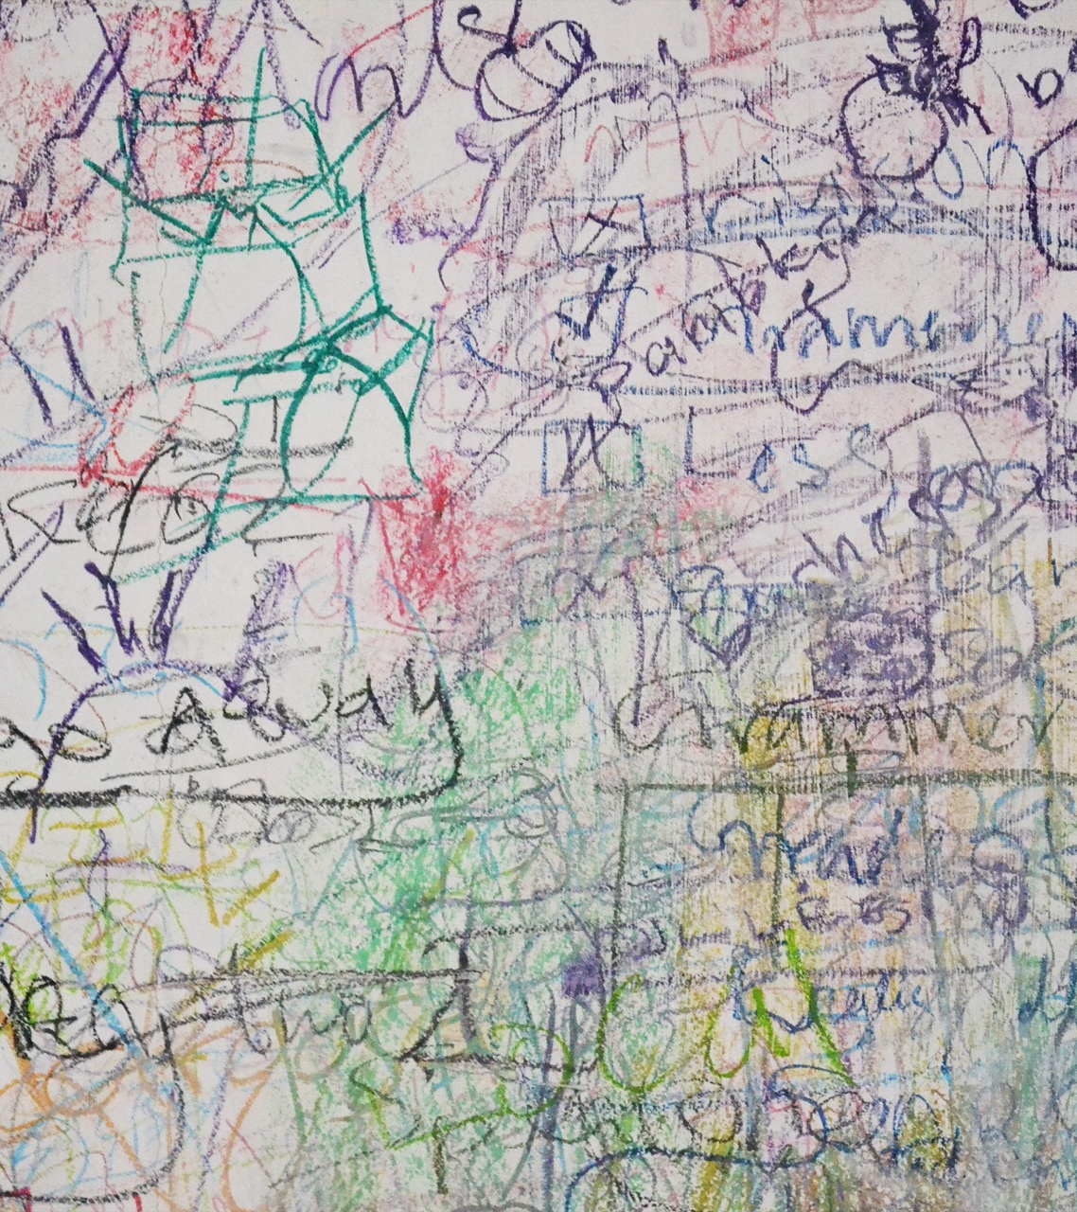
Why like this?

Slide 12
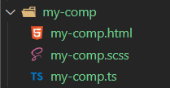
my-comp.scss
:host {
background-color: $primary-color;
}
You are an Angular Component Library Developer
You create component SCSS files
And need to use a variable the user defines
In his styles.scss How do you get the $primary-color variable?

Slide 13
_theme.scss
@mixin my-comp-style($primary-color) {
:host {
background-color: $primary-color;
}
}
Provide the styling as mixin Accept the theme colors as paramerter
Yack!

Slide 14
styles.scss
@use '@angular/material’ as mat;
@include mat.core();
$my-primary: mat.define-palette(mat.$indigo-palette);
$my-accent: mat.define-palette(mat.$pink-palette);
$my-warn: mat.define-palette(mat.$red-palette);
$my-theme: mat.define-light-theme((
color: (
primary: $my-primary,
accent: $my-accent,
warn: $my-warn,
),
typography: mat.define-typography-config(),
density: 0,
));
@include mat.all-component-themes($my-theme);

Slide 15

Custom Properties
--my-color: magenta;
background: var(--my-color);

Slide 16
CSS consists of two parts.
Property Value Engine
Visual Renderer
Specifity
Cascading
Layouts
Colors
Effects
Animations
Inheritance
Selectors

Slide 17

css-vars.css
css-vars.css
/* Custom properties */ :root { --my-prop: 50; --my-color: magenta; }
/* Custom properties */ h1 { color: var(--my-color); text-decoration: var(--my-color) underline; }

Slide 18
Relative Color Syntax
background: hsl(from blue h s calc(l * 0.8));

Slide 19
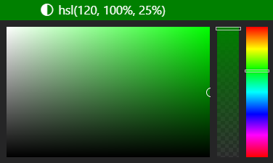
HSL
Hue
Choose the base color on the color wheel
Saturation
Choose how intense you want it
Lightness
Choose how bright you want it
From 0% (light’s off – black) to 100% (light’s fully on, bright)
From 0 degrees to 360
From 0% (grayscale) to 100% (fully saturated)
Hue, Saturation, Lightness

Slide 20
Mixing Colors
background:
color-mix(in srgb, blue, white 50%);

Slide 21
Color Schemes
Hello World
color-scheme: light
Hello World
color-scheme: dark

Slide 22
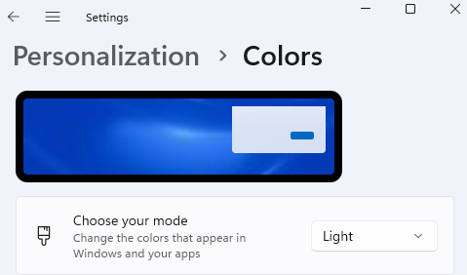
Color Schemes
color-scheme: light dark; // by system

Slide 23
Mixing Colors
color-scheme: light; background:
light-dark(lightblue, darkblue);
color-scheme: dark; background:
light-dark(lightblue, darkblue);

Slide 24
Angular Material 19+
Design Tokens
No more component Style Generations
Each Theme supports both light and dark modes

Slide 25
Theme
Setup
styles.scss
@use '@angular/material' as mat;
html {
color-scheme: light-dark;
@include mat.theme((
color: (
primary: mat.$violet-palette,
tertiary: mat.$orange-palette
),
typography: Roboto,
density: 0 ));
}

Slide 26
Design Tokens
System Tokens
--mat-sys-primary
#ABDBFF
--mat-sys-on-primary
#004376
Component Tokens
--mat-button-container-color
var(--mat-sys-on-primary)

Slide 27



Theming Angular & Material MD3 The missing guide by Kobi Hari

